Slide 1
CMSC201 Computer Science I for Majors Lecture 22 – Binary (and More)

Slide 2
Last Class We Covered
Dictionaries
Creating
Accessing
Manipulating
Methods
Dictionaries vs Lists

Slide 3
Any Questions from Last Time?

Slide 4
Today’s Objectives
To understand how data is represented and stored in memory
Binary numbers
Floating point errors
ASCII values
To see the benefits of short circuit evaluation
To learn about other programming languages

Slide 5
Binary Numbers

Slide 6
Binary Numbers
Computers store all information (code, text, images, sound,) as a binary representation
“Binary” means only two parts: 0 and 1
Specific formats for each file help the computer know what type of item/object it is
But why use binary?

Slide 7
Decimal vs Binary
Why do we use decimal numbers?
Ones, tens, hundreds, thousands, etc.
But computers don’t have fingers…
What do they have instead?
They only have two states: “on” and “off”
Notes:
We use decimal because we have 10 fingers, or 10 different things we can use to count with.

Slide 8
Decimal Example
How do we represent a number like 50,932?
2 x 10⁰ = 2
3 x 10¹ = 30
9 x 10² = 900
0 x 10³ = 0000
5 x 10⁴ = 50000
------
Total: 50932
ten thousands
thousands
hundreds
tens
ones
5
0
9
3
2
10⁴
10³
10²
10¹
10⁰
Decimal uses 10 digits, so…

Slide 9
Another Decimal Example
6 | 7 | 4 | 9 | 3
10⁴ | 10³ | 10² | 10¹ | 10⁰
10000 | 1000 | 100 | 10 | 1
60000 | 7000 | 400 | 90 | 3
60000+7000+400+90+3 = 67493

Slide 10
Binary Example
Let’s do the same with 10110 in binary
0 x 2⁰ = 0
1 x 2¹ = 2
1 x 2² = 4
0 x 2³ = 0
1 x 2⁴ = 16
--
Total: 22
sixteens
eights
fours
twos
ones
1
0
1
1
0
2⁴
2³
2²
2¹
2⁰
Binary uses 2 digits, so our base isn’t 10, but…

Slide 11
Binary to Decimal Conversion
Step 1: Draw Conversion Box
Step 2: Enter Binary Number
Step 3: Multiply
Step 4: Add
2⁹ | 2⁸ | 2⁷ | 2⁶ | 2⁵ | 2⁴ | 2³ | 2² | 2¹ | 2⁰
512 | 256 | 128 | 64 | 32 | 16 | 8 | 4 | 2 | 1
1 | 0 | 1 | 0 | 0 | 0 | 1 | 1 | 0 | 1
512 | 0 | 128 | 0 | 0 | 0 | 8 | 4 | 0 | 1
128 + 0 + 0 + 0 + 8 + 4 + 0 + 1 = 141

Slide 12
Exercise: Converting From Binary
What are the decimals equivalents of…
101
1111
100000
101010
0010 1010
1000 0000
Longer binary numbers are often broken into blocks of four digits for the sake of readability

Slide 13
Exercise: Converting From Binary
What are the decimals equivalents of…
101 = 4+0+1 = 5
1111 = 8+4+2+1 = 15
100000 = 32+0+0+0+0+0 = 32
101010 = 32+0+8+0+2+0 = 42
0010 1010 = 32+0+8+0+2+0 = 42
1000 0000 = 128+...+0+0 = 128

Slide 14
Decimal to Binary Conversion
Step 1: Draw Conversion Box
Step 2: Compare decimal to highest binary value
Step 3: If binary value is smaller, put a 1 there and
subtract the value from the decimal number
Step 4: Repeat until 0
Convert 163 to binary
2⁹ | 2⁸ | 2⁷ | 2⁶ | 2⁵ | 2⁴ | 2³ | 2² | 2¹ | 2⁰
512 | 256 | 128 | 64 | 32 | 16 | 8 | 4 | 2 | 1
1 | 0
1 | 0 | 0 | 0
1
1
163-128 = 35
35-32 = 3
3-2=1
1-1=0

Slide 15
Converting to Binary
What are the binary equivalents of…
9
27
68
216
255

Slide 16
Converting to Binary
What are the binary equivalents of…
9 = 1001 (or 8+1)
27 = 0001 1011 (or 16+8+2+1)
68 = 0100 0100 (or 64+4)
216 = 1101 1000 (or 128+64+16+8)
255 = 1111 1111 (or 128+64+32+16+8+4+2+1)

Slide 17
Binary Tips and Tricks
Some “sanity checking” rules for conversions:
Binary can only be 1 or 0
If you get “2” of something, it’s wrong
Odd numbers must have a 1 in the ones column
Why? (And what’s the rule for even numbers?)
Each column’s value is the sum of all of the previous columns (to the right) plus one
In decimal, what column comes after 999?

Slide 18
Floating Point Errors

Slide 19
Division: Floats and Integers
Floats (decimals) and integers (whole numbers) behave in two different ways in Python
And in many other programming languages
Biggest difference is how division works
Python 3 automatically performs decimal division
Have to explicitly call integer division
Floats also automatically perform decimal division

Slide 20
Division Examples
What do the following expressions evaluate to?
4 / 3
4 // 3
4 // 3.0
8 / 3
8 / 2
5 / 7
5 // 7
= 1.3333333333333333
= 1
= 1.0
= 2.6666666666666667
= 4.0
= 0.7142857142857143
= 0

Slide 21
Floating Point Errors
In base 10, some numbers are approximated:
0.66666666666666666666666667…
3.14159265358979323846264338328…
The same is true for base 2
0.00011001100110011001100… (0.1 in base 10)
This leads to rounding errors with floats
General rule: Don’t compare floats for equality after you’ve done division on them!

Slide 22
ASCII Values

Slide 23
ASCII Values
ASCII is how text is represented in computers
Just like binary is how numbers are represented
In ASCII, every character has a unique, individual numerical code
Lowercase and uppercase characters are separate
Codes go from 0 to 127
Why 127?

Slide 24
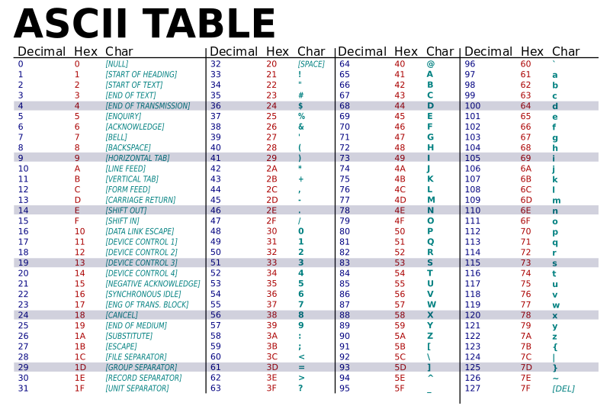
Image from wikimedia.org
Notes:
https://commons.wikimedia.org/wiki/File:ASCII-Table-wide.svg

Slide 25
“control” characters
uppercase letters
symbols & numbers
lowercase letters
Image from wikimedia.org
Notes:
https://commons.wikimedia.org/wiki/File:ASCII-Table-wide.svg

Slide 26
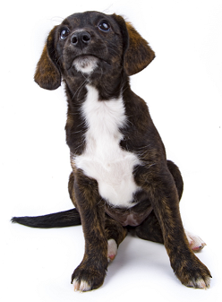
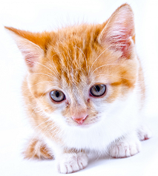
Comparing Strings
The values of the ASCII characters are used when comparing strings together
Which can lead to some “weird” results
>>> "cat" < "dog"
True
>>> "cat" < "Dog"
False
>>> "DOG" < "dog"
True
<
Images from publicdomainpictures.net
Notes:
http://www.publicdomainpictures.net/view-image.php?image=87454&picture=cat
http://www.publicdomainpictures.net/view-image.php?image=192231&picture=puppy-dog-on-white

Slide 27
More on Comparing Strings
Gets even more complex when you start adding in numbers and symbols
>>> "2" < "one"
True
>>> "good?" < "good!"
False
>>> "UK" < "U.K."
False

Slide 28
Rules for Comparisons
To avoid (some) of these issues:
Always use .lower() for comparing strings
Pay attention to symbols
e.g., spaces, hyphens, punctuation, etc.
Either remove them, or keep as part of the order

Slide 29
ASCII Characters to ASCII Values
We can convert between ASCII characters and their values using ord() and chr()
The ord() function takes in a single character, and returns its ASCII value
The chr() function takes in an integer, and returns its ASCII character

Slide 30
Using chr() and ord()
>>> chr(65)
'A'
>>> chr(65+32)
'a'
>>> ord('?')
63
>>> ord("d")
100
>>> ord("e")
101

Slide 31
“Short Circuit” Evaluation

Slide 32
Review: Complex Expressions
We can put multiple operators together!
bool4 = a and (b or c)
What does Python do first?
Computes (b or c)
Computes a and the result
This isn’t strictly true!

Slide 33
Short Circuit Evaluation
Python tries to be efficient (i.e., lazy), and so it won’t do any more work than necessary
If the remainder of an expression won’t change the outcome, Python doesn’t look at it
This is called “short circuiting”
“and” statements short circuit as soon as an expression evaluates to False
“or” statements short circuit as soon as an expression evaluates to True

Slide 34
Short Circuiting – and
Notice that in the expression:
bool1 = a and (b or c)
If a is False
The rest of the expression doesn’t matter
Python will realize this, and if a is False won’t bother with the rest of the expression

Slide 35
Short Circuiting – or
Notice that in the expression:
bool1 = a or (b or c)
If a is True
The rest of the expression doesn’t matter
Python will realize this, and if a is True won’t bother with the rest of the expression

Slide 36
Causing Errors
This can lead to “new” errors in old code
>>> a = True
>>> # Variables b and c not defined
>>> a or (b and c)
True
>>> a = False
>>> a or (b and c)
Traceback (most recent call last):
File "<stdin>", line 1, in <module>
NameError: name 'b' is not defined
Python stopped at the “or”, so it never saw b or c

Slide 37
Programming Languages

Slide 38
“Levels” of Languages
Machine Code (lowest level)
Code that the computer can directly execute
Binary (0 or 1)
Low Level Language
Interacts with the hardware of the computer
Assembly language
High Level Language
Compiled or interpreted into machine code
Java, C++, Python

Slide 39
Compilation vs Interpretation
Compiler
A complex computer program that takes another program and translates it into machine language
Compilation takes longer, but programs run faster
Interpreter
Simulates a computer that can understand a high level language
Allows programming “on the fly”

Slide 40
Announcements
Homework 6 out on Blackboard
Homework due Friday, April 28th @ 8:59:59 PM
Project 3 will be out Saturday
Also going to be on recursion
Final exam is Friday, May 19th from 6 to 8 PM

